Slide 1
DATA ANLYTICS & VISUALIZATION
Introduction
Q.What is Data Analytics ?
Generally, this process begins with descriptive analytics. This is the process of describing historical trends in data.
advanced tools to extract data, make predictions and discover trends. These tools include classical statistics as well as machine learning. Machine learning technologies such as neural networks, natural language processing, sentiment analysis and more enable advanced analytics. This information provides new insight from data.
Akash Kumar (17BIT0055)

Slide 2
DATA ANLYTICS & VISUALIZATION
I hereby declare that the project report entitled “Data Analytics & Visualization” submitted by me to School of Information Technology & Engineering, Vellore Institute of Technology University, Vellore in partial fulfillment of the requirement for the award of the degree of B.Tech (Information Technology) is a record of bonafide Industrial Internship – ITE3099 work carried out by me. I further declare that the work reported in this Industrial Internship report has not been submitted and will not be submitted, either in part or in full, for the award of any other degree or diploma in this institute or any other institute or university.

Slide 3
ACKNOWLEDGEMENT
I have successfully completed “Data Analytics & Visualization” internship in Medulance. I got to learn various new aspects and latest technology of robotics. I got to enhance my practical as well as theoretical skills in engineering throughout this internship program. It has been my privilege to have a team of project guide who have assisted me from the commencement of this project. The success of this project is a result of sheer hard work, and determination put in by me with the help of my project guide. I would also like to acknowledge and my heartfelt gratitude to Mr. Ravjot Arora (Project Head) who continuously supported me in every possible way, from initial advice to encouragement to complete my internship successfully. His wisdom, knowledge, and commitment to the highest standards inspired and motivated me. Without his insight, support, and energy, this project wouldn't have kick-started and neither would have reached fruitfulness. I express my immense pleasure and deep sense of gratitude to Mr. Ravjot Arora for giving me this opportunity and the guidance throughout the program. The project is dedicated to my partner Manish and all those people, who helped me while doing this project.

Slide 4
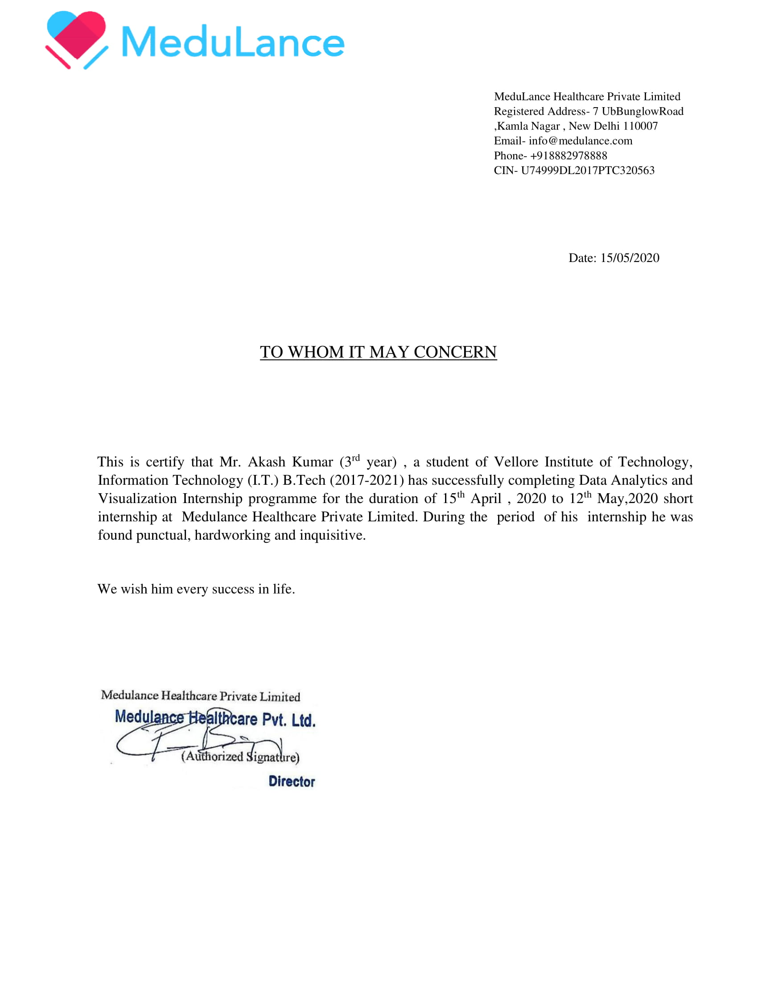
CERTIFICATE ISSUED BY THE ORGANIZATION

Slide 5
TABLE OF CONTENTS
CHAPTER NO. | TITLE | PAGE NO.
1. | Abstract | 7
2. | About the Company | 8
3. | Technology Stack | 10
4. | Data Analytics Domain | 11
5. | Knowledge Acquired from Training | 12
6. | Work Details | 14
7. | Application | 18
8. | Market Adoption | 19
9. | Conclusion | 20

Slide 6
Abstract
The internship at Medulance exposed me to the startup culture and helped me understand the risks of Medical in the initial stages and the amount of work and dedication that is required to bring the product live. I gained valuable insights about how a product is prototyped and how the technical team works and how all the things are managed and developed upon by team members. I learnt about how to analyse & visualize the data from which we can make predictions. And learned how to clean & analyse the data, which comes under exploratory data analysis & finally visualize using libraries & various others tools. I am glad to have learned to develop in this framework through this Internship.

Slide 7
About the Company
Medulance is a Startup company based in Delhi and upgrading and digitalizing the traditional channels that were used to seek help. India's first, GPS based technology platform for fast and reliable first point medical attention.With an increasing emphasis on promoting independent living today, having access to the nearest ambulance to you can provide much needed peace of mind in a worst case scenario.
Our technology platforms were built to connect the customers and the ambulance drivers directly with each other in the time of need. We strive to provide high-quality, clean ambulances at competitive prices within minutes, assisting the every day superheroes to reach the patients faster with the help of an easy and simple format. We believe that ambulances should be able to help you when it matter
Our mission is to inspire breakthroughs in the way India looks at ambulances and first point medical attentions, and to touch lives. Our values serve as a compass for our actions and describe how we behave in the world.

Slide 8
SERVICES
Data Analytics
Data analysis solution which work on principle of ‘Identification of the problem’, ‘Designing Data Requirement’, ‘Pre-Processing Data’, ‘Performing Analytic over data and ‘Visualization of data’.
b. To make ambulances available for 24hrs
Our technology platforms were built to connect the customers and the ambulance drivers directly with each other in the time of need. We strive to provide high-quality, clean ambulances at competitive prices within minutes, assisting the every day superheroes to reach the patients faster with the help of an easy and simple format.
c. Medical Healthcare
India's Leading comprehensive emergency response service provider
d. GPS based Technology
GPS based technology platform for fast and reliable first point medical attention

Slide 9
Technology Stack
Python
This programming language is used for making chatbot.
Flutter
Develop applications for Android, iOS, Linux, Mac, Windows, Google Fuchsia and the web from a single codebase. The first version of Flutter was known as codename "Sky" and ran on the Android operating system.
Data Analytics
Get to know the regions with most disease people in nearby area by using some analysis & making predictons & supporting decision-making

Slide 10
Data Analytics Domain
Data Analytics refers to the set of quantitative and qualitative approaches for deriving valuable insights from data. It involves many processes that include extracting data and categorizing it in order to derive various patterns, relations, connections, and other such valuable insights from it.
Today, almost every organization has morphed itself into a data-driven organization, and this means that they are deploying an approach to collect more data that is related to their customers, markets, and business processes. This data is then categorized, stored, and analyzed to make sense out of it and derive valuable insights from it.

Slide 11
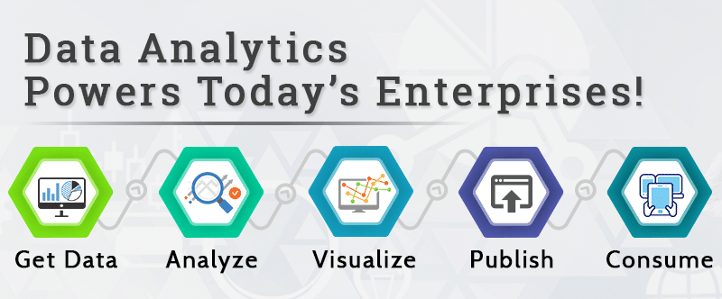

Slide 12
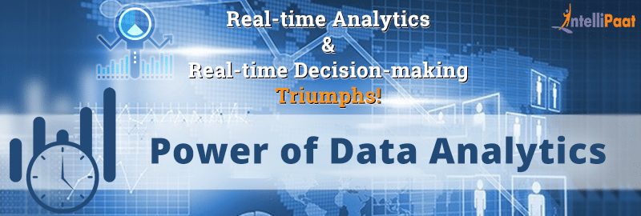
The larger the size of the data the bigger the problem. So, big data may be defined as the data the size of which itself poses the problem and which needs newer ways of handling it. So, the analysis of data at high volume, velocity, and variety means that the traditional methods of working with data would not apply here.

Slide 13
Knowledge Acquired from Training Data Analysis & Visualization
This project deals with covid-19 data analysis on datasets & analyze & predict the patterns for up-coming future.
And how this analysis can be helped in how much will it spread & which are most dangerous locations, called as hotspot
To help them in project, they told me to learn some basic tools & technologies, which will be further needed while performing exploratory data analysis & visualize the graphs & charts.
Process include :
Data Collection
(EDA)Exploratory data analysis(Feature engineering,Feature Selection,Preprocessing,data cleaning,handling missing values in dataste)
Model building(ML/DL) & selction suitable algorithm(supervised,un-supervised,reinforement) model for training,testing,Accuracy
Deployment using AWS & Heroku, everyone can have access & be public
PPT making, how your prediction can help company from other competitor & benefit & rise in economy

Slide 14
Feature engineering(Pre-processing) & feature selection, for data cleaning, this is step/process covers 80% of major work & it is most important part of timeline.
Data cleaning(handling missing vlaues) can be done in 3 ways:
By taking mean,median,mode of data
By imputation
By replacing most repeated values
This can be done throughly with good understanding & analysing the data, what it is saying.
This process require, numpy,pandas,matplotlib,seaborn & some statistics techniques/topics needed & pick the best approach.
I applied all ML algorithmns(SVM,Naive bayes,Linear,Logistic,kNN,Kmeans,Random forest) to measure best accuracy,i.e., which one is providing more accurate & perfect predicton, we choose that algorithm
Performed some trainig & testing on models & validate the results

Slide 15
After EDA & model building, I need to visualize the data, what is it saying? What will be covi-19 predictions? how much will it spread?
All these questions & thoughts needs to be taken care while visualizing the graphs & charts, which is output of analysis. So, prepared a list of questions & answers to express my understanding & thoughts of visualizations I got & make them understand in best possible way.
They told to make a PPT & include all your process, steps, & timeline & your views, thought.
This was require because they want to test my communication skills, how well I can express myself to my colleagues & company benefit.
I made PPT & tried my best to understand them my all the cycle of data analysis & visualizations of project.
And also how my accurate predictions can help in determining how much more covid-19 spread in up-coming months.

Slide 16
Application
Features of Medical HealthCare Domain
Safe: Avoiding harm to patients from the care that is intended to help them.
Effective: Providing services based on scientific knowledge to all who could benefit and refraining from providing services to those not likely to benefit (avoiding underuse and misuse, respectively).
Patient-centered: Providing care that is respectful of and responsive to individual patient preferences, need
GPS based technology platform for fast and reliable first point medical attention.
With an increasing emphasis on promoting independent living today, having access to the nearest ambulance to you can provide much needed peace of mind in a worst case scenario.
You can book from anywhere
Its flexible & user friendly interface
One touch access to medical emergency services.
Seamless communication with ambulance drivers

Slide 17
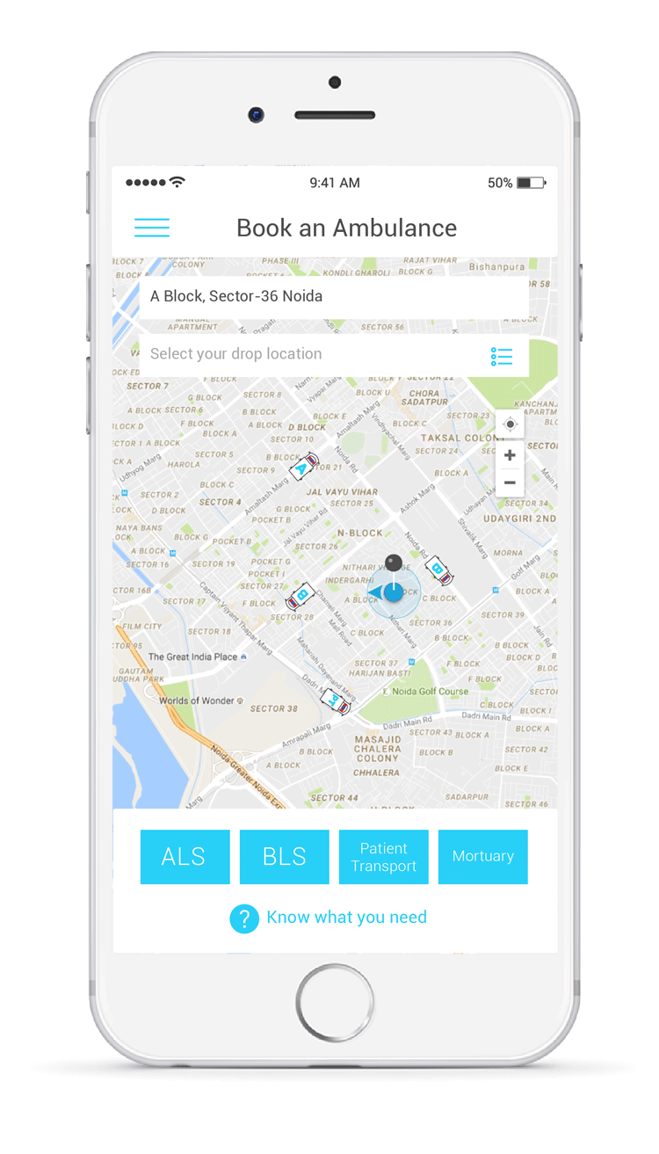
Market Adoption
You can book from anywhere
Its flexible & user friendly interface
Previous years, our application helped a lot & been used my many peoples
Take immediate action & no delay in transporting
GPS based technology platform for fast and reliable first point medical attention.
With an increasing emphasis on promoting independent living today, having access to the nearest ambulance to you can provide much needed peace of mind in a worst case scenario.
One touch access to medical emergency services.
Seamless communication with ambulance drivers

Slide 18
Conclusion
The given tasks were successfully implemented in the internship period. It was overall a good learning experience. I learned new tools, frameworks and experience of working with Medulance team.
During this period, I worked in various areas like python and data analytics successfully met the objectives that were set at the beginning of the project.
I am thankful to Medulance for providing me this opportunity to develop and apply my skills. I am grateful to my mentors for providing me the necessary training and guidance. It was a very valuable training, in which I learned this popular skillset which is high in demand in robotics. The experience and skills gained will surely be of great benefit in my career.

